Slide 1
DDI at the Australian Data Archive Steve McEachern Deputy Director, ADA with Deborah Mitchell (ADA), Ben Evans and Olaf Delgado-Friedrichs (ANUSF)
EDDI Conference
December 2011

Slide 2
Presentation Overview
About ADA
ADA in brief
The ADA sub-archive system
ADA website and DDI
Browsing
Searching
Viewing data and metadata
New tools
Data visualisation: GIS, Longitudinal
Data deposit: ADAPT
Current experiences with DDI
Future directions

Slide 3
1. About ADA

Slide 4
ADA in Brief
The Social Science Data Archive (now ADA) was set up in 1981, housed in the Research School of Social Sciences, Australian National University, with a mission to collect and preserve Australian social science data on behalf of the social science research community
Now includes nodes at University of Melbourne, University of Queensland, University of Western Australia, University of Technology Sydney, with infrastructure provided by the ANU Supercomputer Facility
The Archive holds some 2400 data sets, including national election studies; public opinion polls; social attitudes surveys. Data holdings are sourced from academic, government and private sectors.

Slide 5
ADA NCRIS/NeAT development
The original research community needs identified by the ASSDA Advisory Panel to be addressed by the ASeSS project were as follows:
A coherent single point of access for nationally significant social science and associated humanities resources, including access for researchers, students, government bodies, and other external agencies.
Reliable access to the major national social surveys.
Management of a diverse range of data forms needed to help answer research questions across these different forms: eg: unit record data, qualitative data, economics data, including a high level of data documentation that allows researchers to quickly identify its relevance and quality for research purposes.
Easy access to specialised collections, eg: topic based data, such as data relating to ageing; colonial data; indigenous data.
Provide fast search across all this data.
Easy access to data analysis tools, including the development of advanced analytical and visualisation tools and capability (outside of commercially available products) that provide additional value to the data archives and support the ‘unlocking’ of otherwise inaccessible data sets of national significance.
Computational modelling, expertise and resources including computationally expensive statistical packages.

Slide 6
ADA Subarchives
Social Science – predominantly survey or polling based quantitative social science data
Historical – an archive of Australian census data tables from 1834 to the present day
Indigenous – A thematic archive bringing together research data about Aboriginal and Torres Strait Islanders
Longitudinal –major longitudinal cohort and panel surveys of the Australian population
Qualitative – a new collection which provides specialist data archiving and access services to qualitative researchers
Crime & Justice – major collections of data in crime, law and justice, including criminal justice administrative data
International – a central point of access for links to international data sources around the world

Slide 7
The ADA Website and DDI

Slide 8
Approach
Core archive website:
http://www.ada.edu.au
Sub-archives focussed on specialised thematic or methodological areas
eg. http://www.ada.edu.au/indigenous/home
“Add-on” systems for complex analysis or visualisation tasks:
Nesstar
GIS: http://gis-test.ada.edu.au
Longitudinal visualisation: Panemalia
Historical census data: http://hccda.ada.edu.au

Slide 9
New OAIS architecture

Slide 10
The ADA website

Slide 11
Data Access

Slide 12
Finding data
There are two methods for finding data in the Australian Data Archive:
Browsing the ADA Data Catalogue
Searching for data using the ADA search engine
Searching or browsing from within one of the ADA subarchives automatically limits the results to data from within that subarchive.

Slide 13
Search results

Slide 14
Browsing the catalogue

Slide 15
The ADA study page
Study information is available through the tabs at the top of the study:
Study: information including the investigators, abstract, sample, data collection methods, and access requirements.
Variables: a list of variables available in a quantitative dataset
Related Materials: additional documentation, links and other related studies (eg. others in the series) that may interest you
The study page is also the access point for the ADA Nesstar system, for:
Analysis of quantitative data online,
Download of data to your own computer.

Slide 16
The ADA Study Page

Slide 17
Other ADA functions

Slide 18
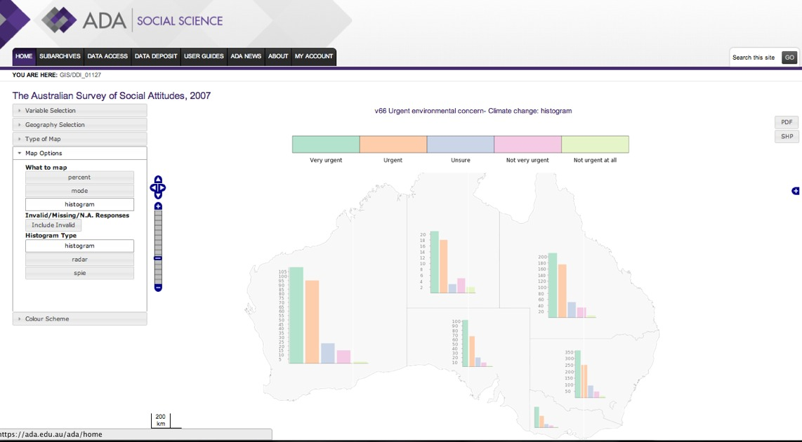
GIS visualisation
http://gis.ada.edu.au

Slide 19
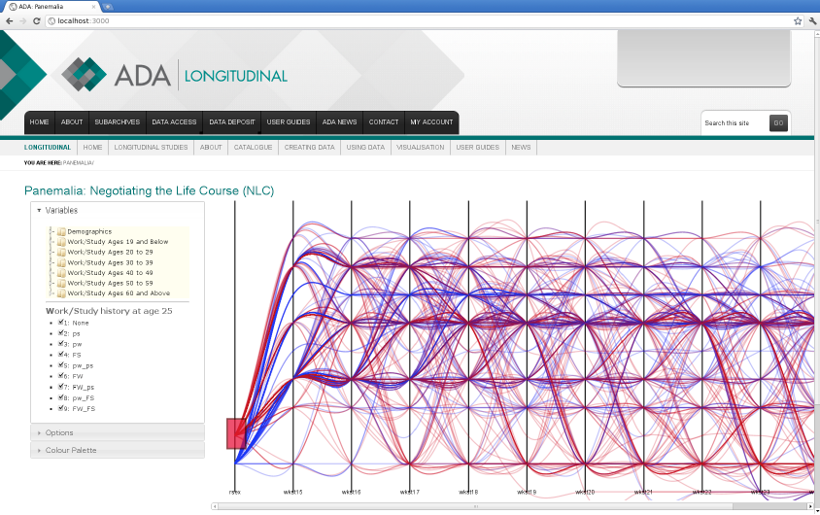
Longitudinal visualisation

Slide 20
Data deposit: ADAPT

Slide 21
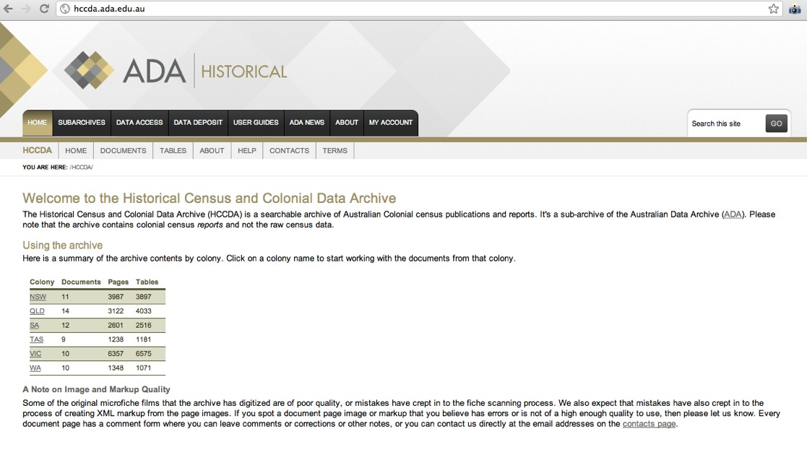
Historical Census data
http://hccda.ada.edu.au

Slide 22
Current experiences and future directions

Slide 23
Where are we now?
New archive interface: http://www.ada.edu.au
New thematic collections (indigenous, crime and justice, historical census, international)
New methodological collections (longitudinal, qualitative)
New analytical tools (particularly in visualisation)

Slide 24
Current experiences
Ingest and archiving
DDI provides core of all of our data deposit and archival processes
Nesstar provides storage foundation
Access
Access services involve various transformations for data discovery and access
CMS consumes DDI metadata
Longitudinal and GIS viz systems require further processing:
ADA’s use of geographic attributes are inconsistent over time
Longitudinal data management not suited to DDI2/DDI-C

Slide 25
Where to from here?
Audio-visual (LIEF 2011-12)
NeCTAR program: Data integration
Secure data access (administrative data, data linkage)
Qualitative data documentation and analysis
Historical/time series spatial analysis
Geospatial and temporal data integration
Integration across content types – eg.
Election results, poll results, candidate surveys
Census, survey and administrative data on a topic (eg. crime)

Slide 26
Questions or comments? For further information Web: http://www.ada.edu.au Email: ada@anu.edu.au

